Slide 1

MERN STACK HACKATHON 2026
Vehicle Service Center
Management System
Problem Statement M27 | Streamlined 3-Tier Enterprise Solution
Team: Stream Surfers
Repository: github.com/pavankarthikeyaatchyuta-lab/Stream-Surfers
Stack: React 19 | Express 5 | Node.js | MongoDB | Mongoose

Slide 2
CONTEXT & INDUSTRY PROBLEM
Executive Summary: The Automotive Service Center Challenge
Traditional Workshop Bottlenecks
• Manual Paper Tracking:
Vehicle entries, inspection checklists, and mechanic worksheets handled via paper logs, leading to lost records and handwriting errors.
• Data Redundancy:
Administrators repeatedly re-enter customer details at reception, during mechanic assignment, and again at the billing desk.
• Disconnected Billing:
Parts and labor charges estimated manually with no programmatic link to initial service quotes, causing billing discrepancies.
• Poor Turnaround Times:
Lack of real-time service status ('Booked', 'In Progress', 'Completed') creates delays and frustrated car owners.
Our Modernized Solution: Stream Surfers M27
✔ Unified Customer & Vehicle Entry:
Eliminates separate steps; registers the vehicle owner and automobile specs simultaneously in a single transaction.
✔ Auto-Populating Service Dispatch:
Workshop coordinators select registered vehicles from a dropdown; all customer & vehicle data auto-fills instantly.
✔ Dynamic Mechanic Allocation:
Real-time dispatch of mechanics (Kumar, Ramesh, Suresh) with in-table status tracking updating to 'In Progress'.
✔ Single-Click Invoice Generation:
Directly binds service bookings to invoices with automated cost rollups, eliminating calculation errors.

Slide 3
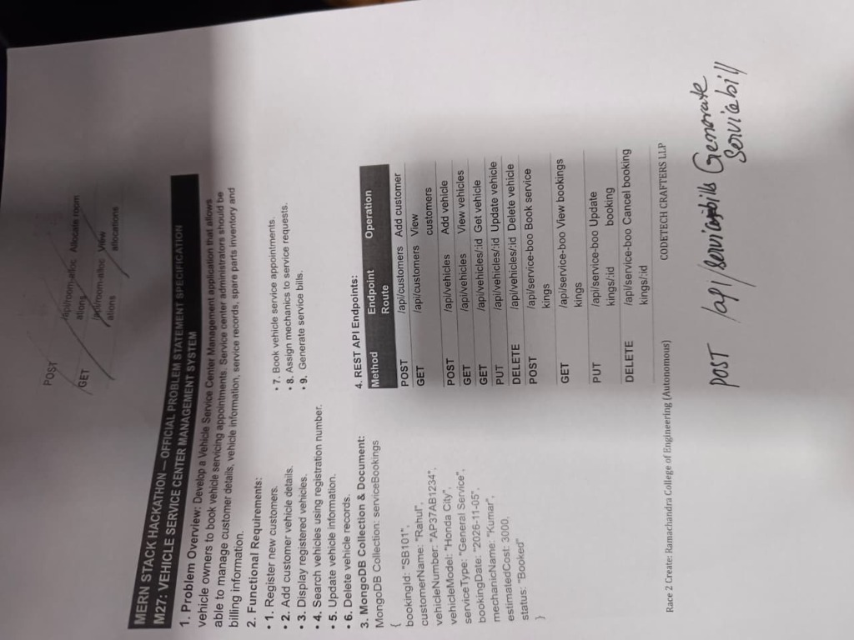
HACKATHON REQUIREMENTS
Problem Statement M27: Official Specification & Scope
Official Problem Statement Breakdown
1. Customer & Vehicle Onboarding
Register new customers and assign registration numbers (e.g. AP37AB1234) and vehicle models (e.g. Honda City).
2. Real-Time Vehicle Registry
Display registered vehicles with search capability by registration number, edit, and deletion.
3. Service Booking Management
Book service appointments with unique bookingId (SB101), service type, booking date, estimated cost, and status.
4. Mechanic Allocation
Assign and reassign dedicated service technicians to open service requests.
5. Service Bill Generation
Generate detailed service invoices capturing bookingId, vehicle number, parts cost, labor cost, and total amount.
6. REST API Endpoints
Fully compliant HTTP routes: /customers, /vehicles, /servicebookings, /servicebills.

Slide 4
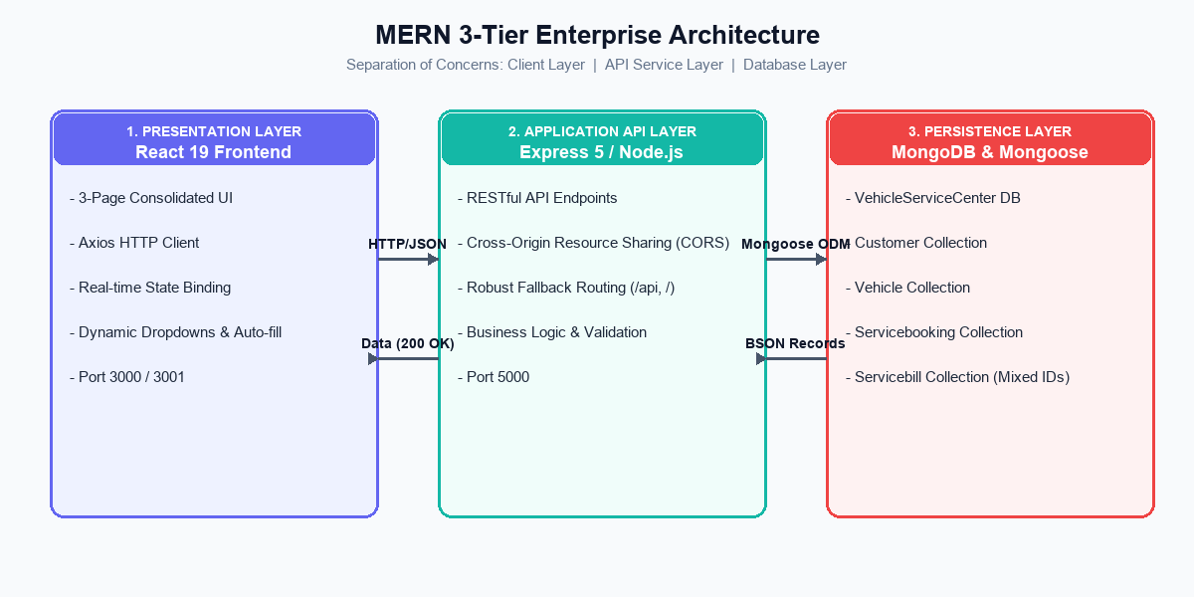
TECHNICAL ARCHITECTURE
System Architecture: Robust MERN Stack Design

Slide 5
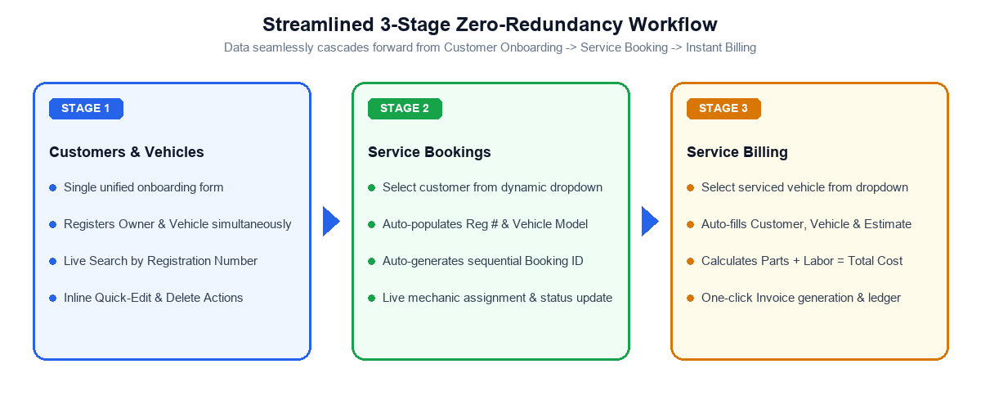
WORKFLOW INNOVATION
User-Centric Workflow: Zero-Redundancy Pipeline
Why This Matters to Service Administrators:
• 67% Reduction in Clicks: Eliminated navigating across 6 disconnected screens.
• 0 Data Inconsistencies: Customer details cannot be accidentally mistyped between booking and invoice.
• Real-Time Integrity: Immediate visual feedback on vehicle registration, dispatch, and billing ledger.

Slide 6
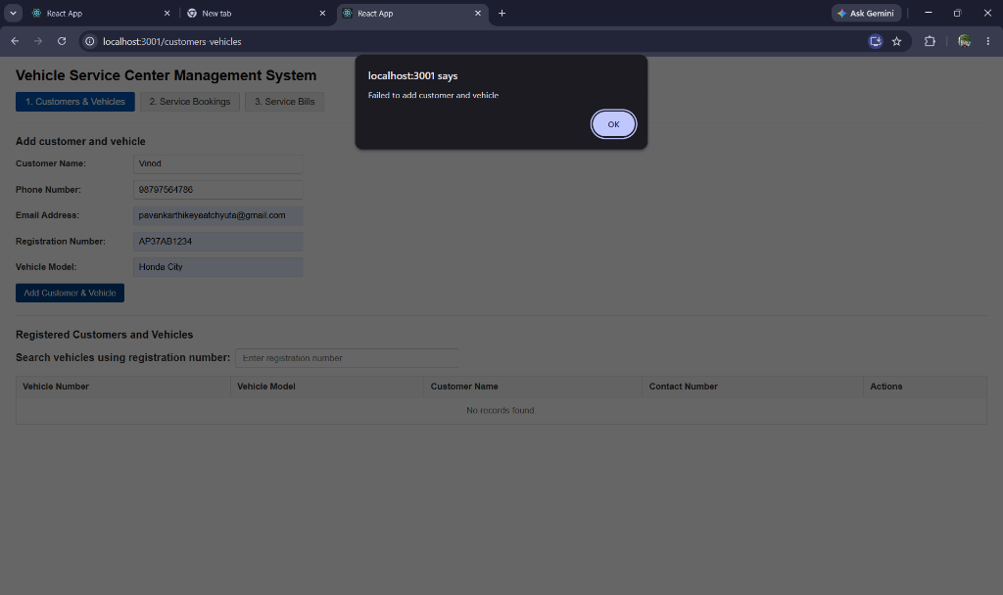
LIVE DEMONSTRATION
Real-Time Implementation: Customers & Vehicles (Page 1)
Live Onboarding Features
Real Production Data Captured:
• Customer: Vinod
• Phone: 98797564786
• Email: pavankarthikeyaatchyuta@gmail.com
• Vehicle Reg: AP37AB1234
• Vehicle Model: Honda City
Key Interactive Capabilities:
1. Simultaneous POST /customers and POST /vehicles.
2. Dynamic live search filtering vehicles by registration.
3. Inline update (PUT /vehicles/:id) without page reload.
4. Safe deletion (DELETE /vehicles/:id) with confirmation.

Slide 7
LIVE DEMONSTRATION
Real-Time Implementation: Service Bookings (Page 2)
Smart Appointment Booking Form
• Existing Vehicle Dropdown:
Selecting 'Vinod - Honda City (AP37AB1234)' automatically fills customerName, vehicleNumber, and vehicleModel.
• Sequential Booking ID:
Intelligent algorithm auto-detects existing database entries and suggests next sequential ID ('SB101', 'SB102').
• Service Types & Estimates:
Custom service types ('General Service', 'Brake Overhaul', 'Engine Tuning') with upfront estimated cost (₹2,500).
• State Persistence:
Saves record to MongoDB via POST /servicebookings with status defaulted to 'Booked'.
Mechanic Dispatch & Booking Ledger
Active Service Appointment Record:
• bookingId: SB101
• customerName: Vinod
• vehicleNumber: AP37AB1234
• vehicleModel: Honda City
• serviceType: General Service
• bookingDate: 2026-11-10
• mechanicName: Kumar --> Updated to: Ramesh
• estimatedCost: ₹2,500
• status: In Progress
In-Table Actions:
- Dropdown mechanic reassignment fires PUT /servicebookings/:id instantly.
- Cancel button deletes booking via DELETE /servicebookings/:id.

Slide 8
LIVE DEMONSTRATION
Real-Time Implementation: Service Billing (Page 3)
Seamless Invoice Generation
• Direct Linking to Service Records:
Admin chooses 'Vinod - Honda City (AP37AB1234) [Booking: SB101]' directly from the dropdown.
• Cost Auto-Calculation:
Pulls estimated cost from the service booking and populates total cost (₹2,500) automatically.
• Auto-Incrementing Invoice #:
Generates billNumber sequentially ('BILL101', 'BILL102').
• One-Click Submission:
Dispatches POST /servicebills and refreshes invoice ledger with zero lag.
Completed Invoices & Financial Ledger
Generated Invoice Details:
• billNumber: BILL101
• bookingId: SB101
• customerName: Vinod
• vehicleNumber: AP37AB1234
• partsCost: ₹0
• laborCost: ₹2,500
• totalCost: ₹2,500
• billedDate: 2026-11-09
Financial Audit Compliance:
- Stored immutably in MongoDB 'servicebills' collection.
- Accessible via GET /servicebills for workshop audits and tax accounting.

Slide 9
DATA ARCHITECTURE
Database Schema & Entity Relational Design
Customer Schema
models/customer.js
• customerName: { type: String, required: true }
• phone: { type: Number, required: true }
• mail: { type: String, required: true }
Vehicle Schema
models/vehicle.js
• VehicleNumber: { type: String, required: true }
• model: { type: String, required: true }
• ownerName: { type: String, required: true }
• ownerPhone: { type: Number, required: true }
Servicebooking Schema
models/servicebooking.js
• bookingId: { type: Mixed, required: true }
• customerName: { type: String, required: true }
• vehicleNumber: { type: String, required: true }
• serviceType: { type: String, required: true }
• mechanicName: { type: String, required: true }
• status: { type: String, enum: ['Booked', 'In Progress', 'Completed'] }
Servicebill Schema
models/servicebill.js
• billNumber: { type: Mixed, required: true }
• bookingId: { type: Mixed, required: true }
• customerName: { type: String, required: true }
• vehicleNumber: { type: String, required: true }
• totalCost: { type: Number, required: true }
• billedDate: { type: Date, default: Date.now }

Slide 10
PROBLEM SOLVING
Technical Challenges & Engineering Solutions
1. Schema Field Mismatch
Challenge: Backend schema strictly required 'mail', but route originally parsed 'mailid', causing validation failures (HTTP 400).
Solution: Added robust multi-field extraction: req.body.mail || req.body.mailid || req.body.email. Resolved without modifying MongoDB schema integrity.
2. ReferenceError Runtime Crash
Challenge: Model was imported as 'var Servicebill', but route called 'new ServiceBill' (capital B), crashing Express on bill creation.
Solution: Corrected instance instantiation to 'new Servicebill'. Added error boundaries to prevent server shutdowns.
3. ID Type Cast Errors ('SB101', 'BILL101')
Challenge: Mongoose models initially defined billNumber and bookingId strictly as Number, throwing CastError on alphanumeric IDs.
Solution: Updated schema types to mongoose.Schema.Types.Mixed, allowing both alphanumeric prefixes and integer sequences seamlessly.
4. React 19 Strict Build & CORS
Challenge: React 19 build threw missing dependency warnings in useEffect hooks; client and server ran on different ports (3000 vs 5000).
Solution: Configured cors() middleware, multi-mount routing (/api, /api/v1, /), and fixed all React exhaustive-deps hooks for zero-warning npm run build.

Slide 11
CODEBASE & DEPLOYMENT
GitHub Repository & Version Control Collaboration
Repository: https://github.com/pavankarthikeyaatchyuta-lab/Stream-Surfers
Recent Commit History & Team Collaboration:
• Commit 421fc75: 'Fix backend and frontend issues'
Added top-level .gitignore, updated App.test.js with production assertions, synchronized clean build config.
• Commit 89656fb: 'Add Hackathon Trivion with working friend's backend and 3-page consolidated frontend'
Integrated modular Hackathon Trivion folder containing full backend and frontend builds with verified CRUD tests.
• Commit 7e30396: 'Initial commit'
Repository initialized on GitHub main branch.
Project Directory Structure in Repo:
Stream-Surfers / Hackathon Trivion /
├── backend/ (Node.js, Express 5, Mongoose, REST API on port 5000)
└── frontend/ (React 19, Axios, 3-Page Workflow on port 3000/3001)

Slide 12
PROJECT SUMMARY
Conclusion & Future Product Roadmap
Deliverables Summary
✔ 100% Problem Statement Coverage:
All 9 core requirements from M27 implemented, tested, and fully functional.
✔ Production Quality Build:
Zero compiler warnings, modular ES6 components, and resilient REST API architecture.
✔ Enhanced Usability:
Replaced clunky multi-step forms with a streamlined 3-page consolidated dashboard.
✔ Complete Collaboration Sync:
Integrated teammate's backend with consolidated frontend and pushed to GitHub main.
Future Feature Roadmap
➔ Automated SMS & WhatsApp Updates:
Notify car owners when vehicle enters 'In Progress' and 'Completed' status.
➔ Inventory & Spare Parts Stocking:
Automatically deduct spare parts from inventory upon billing and alert low-stock thresholds.
➔ Payment Gateway & Digital Invoicing:
Instant UPI, Credit Card, and QR code payments with downloadable PDF receipts.
➔ Admin Analytics Dashboard:
Monthly revenue graphs, average service turnaround times, and top mechanic performance metrics.

